Slide 1
Face Detection Viola-Jones Part 3

Slide 2
Today
Administration
The Viola-Jones Face Detection: Big Picture
AdaBoost: Review
AdaBoost in Viola-Jones’ Context: Review
Integral Image: Final Big Speed-up

Slide 3
Assignment I: Over Due!
Edge detections
38 out of 65 submitted
No penalty for late submission, but you do would like to finish it before
10/13 (Mid-term exam)

Slide 4
Assignment 2: To Be Posted Before Thursday
Viola-Jones Face Detection
Boosting
AdaBoost
Integral image
Training vs. testing
No penalty for late submission, but you do would like to finish it before
10/13 (Mid-term exam)

Slide 5
Today
Administration
The Viola-Jones Face Detection: Big Picture
AdaBoost: Review
AdaBoost in Viola-Jones’ Context: Review
Integral Image: Final Big Speed-up

Slide 7
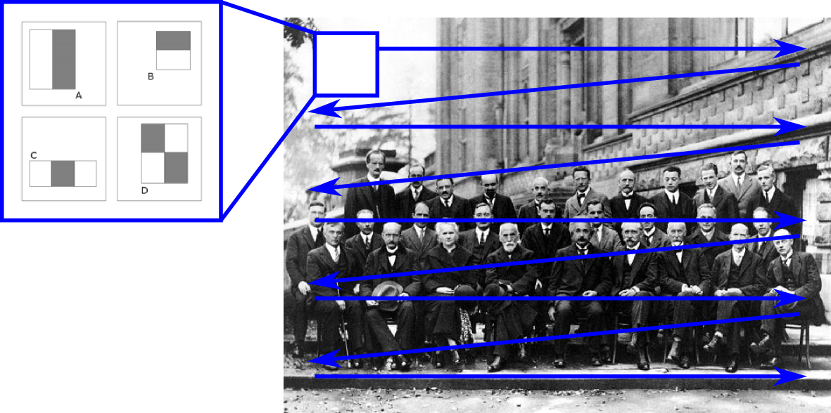
The Viola-Jones Face Detection: Big Picture
Sliding windows
Image credit:
https://sites.google.com/site/5kk73gpu2012/assignment/viola-jones-face-detection

Slide 8
The Viola-Jones Face Detection: Big Picture
Sliding windows
At each position, make a binary decision
How? AdaBoost
What is AdaBoost?
One type of Boosting algorithms
What is Boosting? Weak experts → A strong team
Review AdaBoost: next three slides

Slide 9
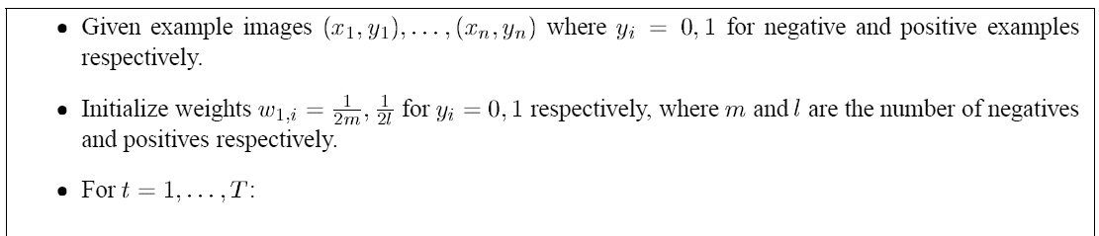
Algorithm 1

Slide 10
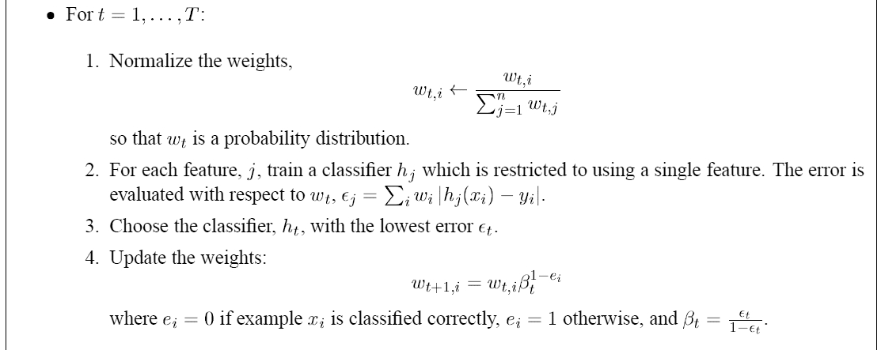
Algorithm 2

Slide 11
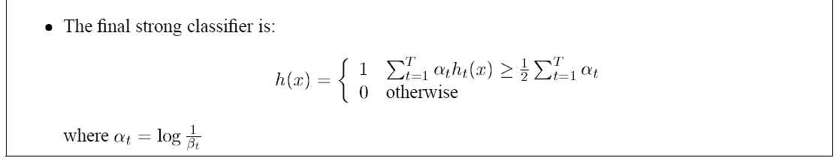
Algorithm 3
The weak experts.
What are they in Viola-Jones’ context of face detection?
Slides 12—22 review the weak experts (a.k.a., Haar-like features)

Slide 12
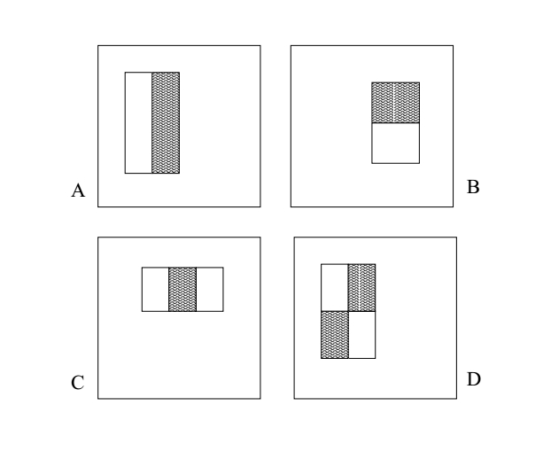
Start with a pattern from below
a.k.a.,
Haar-like features
In the patterns above, the numbers in the region of the white bars are +1,
the black bars have numbers of -1, and the surround background numbers have 0.
The size of each pattern is the same as the size of a training image, typically something
like 50x50 pixels.

Slide 13
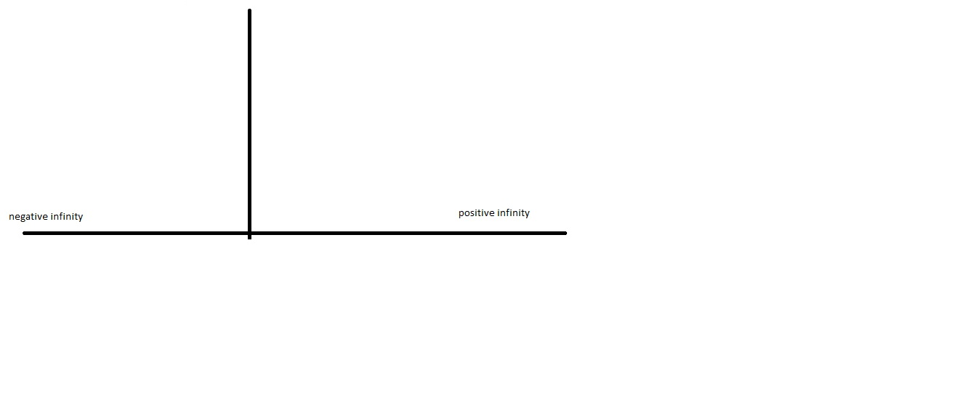
Consider the number line
In all these plots of the number-line, the depiction of the y-axis is irrelevant, and is
only included to indicate that at that position the numbers switch from negative to
positive.
0

Slide 14
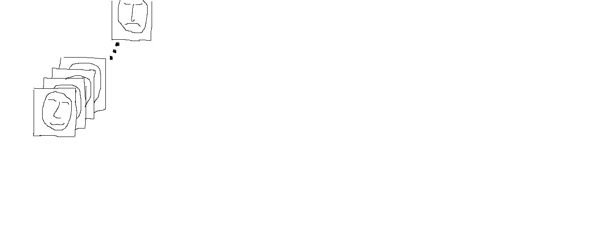

Convolution of pattern with first face
Our Convolution table has a combination of 0’s, +1’s, and -1’s.
Hence, a one-step convolution between the table and our first face
is some integer between negative infinity and positive infinity.
So, plot this resulting integer on the number line.
0

Slide 15

Bring in the second face, and more

Slide 16
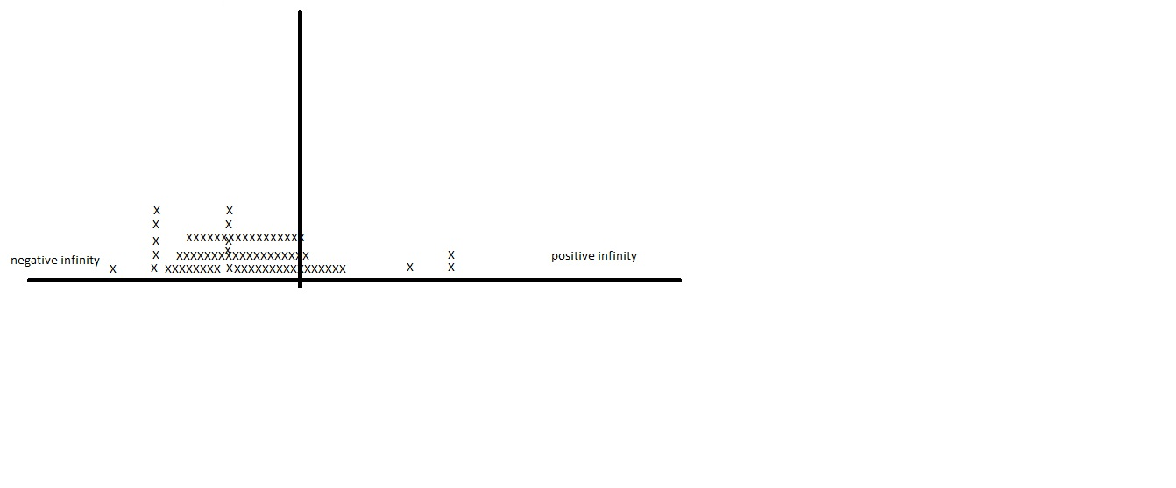
Do all faces

Slide 17
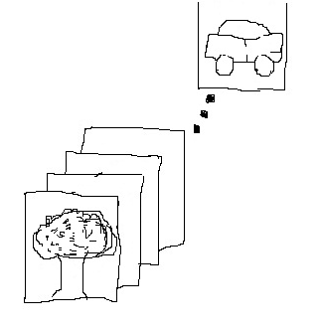
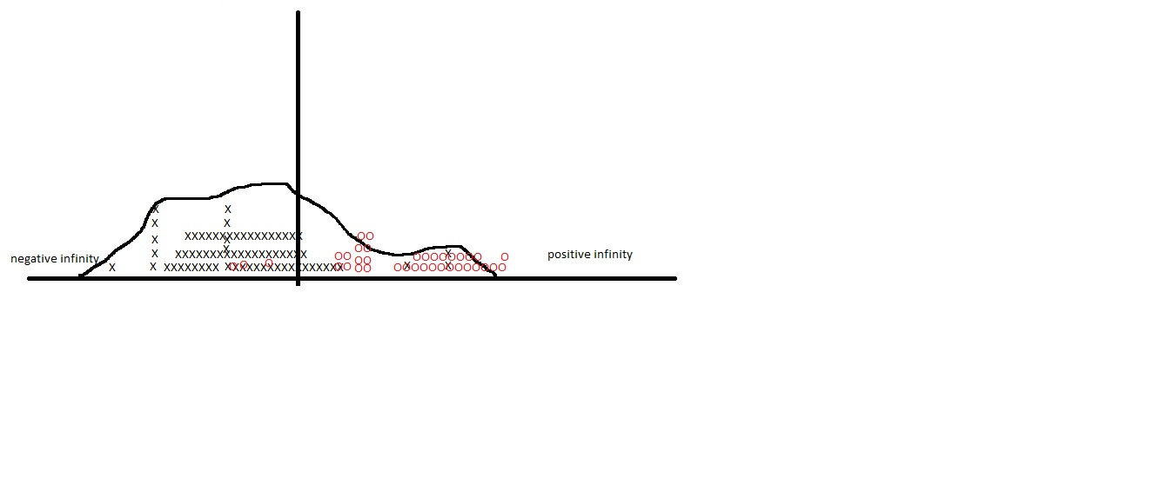
Start putting the non-faces in

Slide 18
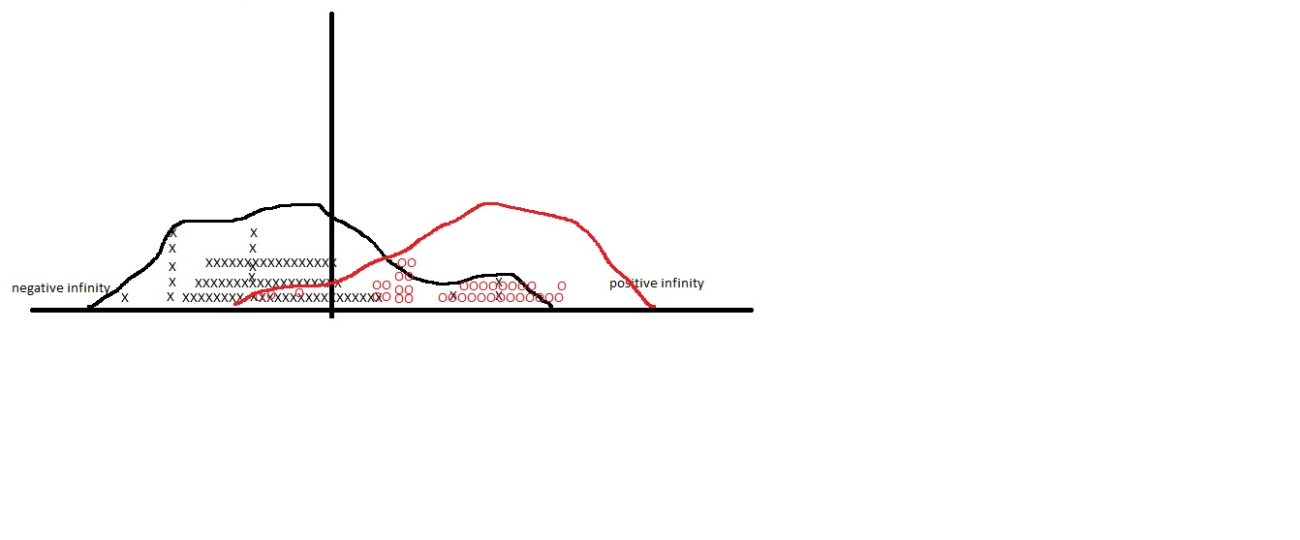
Put them both in

Slide 19
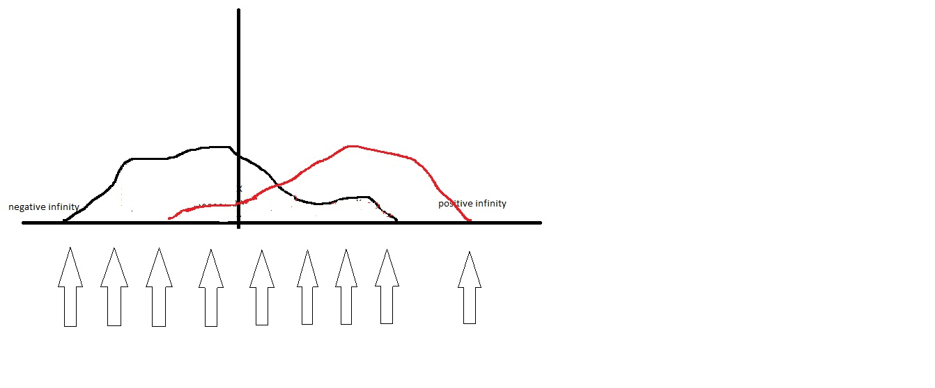
Start search for THRESHOLD
We consider a candidate Threshold (each arrow represents a possible Threshold).
For it, we then ask: Suppose we labeled its left-hand side as the realm of the negatives,
and the right hand side as the realm of the positives; then what would be the error?
i.e., given that parity-sign label, how many example actual positives end up on its left,
and how many actual negatives end up on its right, they constitute its error.

Slide 20
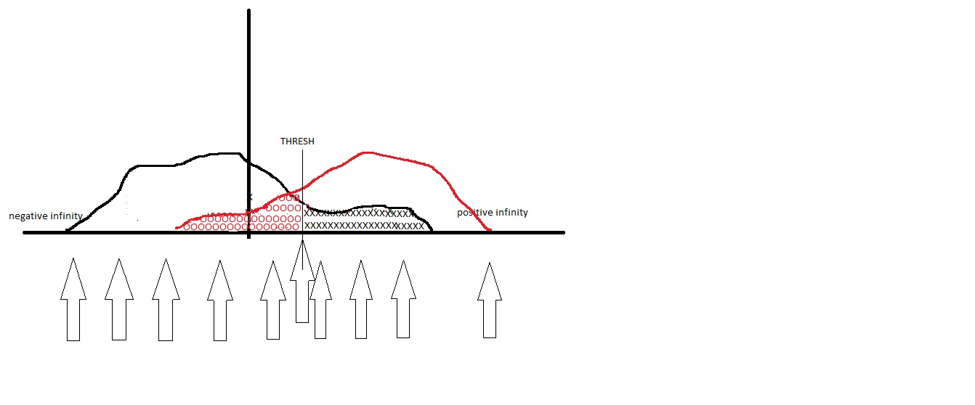
Find the best (i.e., lowest error)
Verify for yourself, that placements other than the one shown as best, would be worse.
We have shown coloring in the error for the best placement.
Now you color in the error for another choice, e.g., the arrow that is 4th from the left.

Slide 21
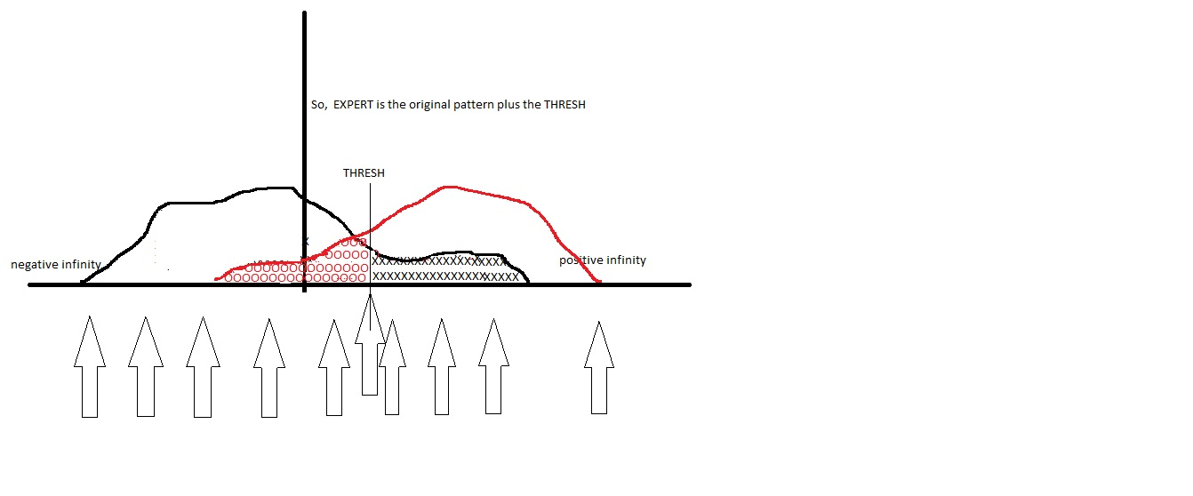
We have got one weak expert, i.e., the pattern + the threshold

Slide 22
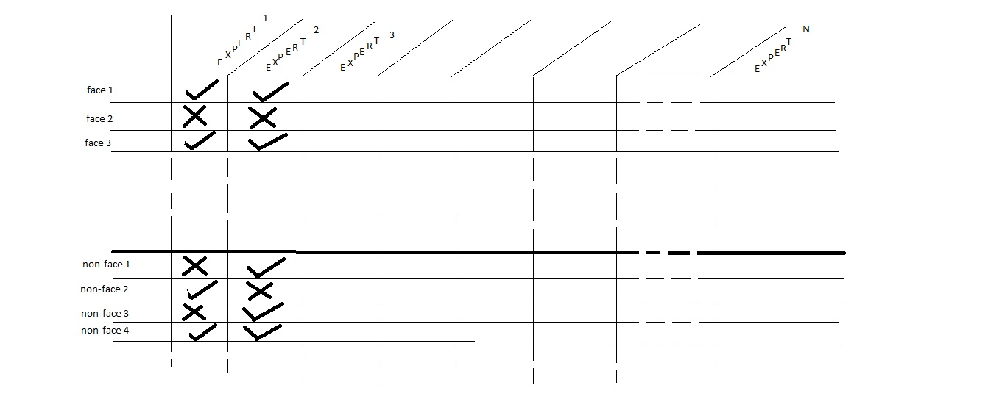
Remember …
So, now we are able to explain how the earlier table is obtained.
i.e., once we have all our experts created (many hundreds of
thousands of them, why so many???), we see how this table can
be populated.

Slide 23
The Viola-Jones Face Detection: Big Picture
Sliding windows
At each position, make a binary decision
How? AdaBoost
What is AdaBoost?
One type of Boosting algorithms
What is Boosting? Weak experts → A strong team
Potential issues?

Slide 24
The Viola-Jones Face Detection: Big Picture
Sliding windows - Potential issues?
Image credit:
https://sites.google.com/site/5kk73gpu2012/assignment/viola-jones-face-detection

Slide 25
The Viola-Jones Face Detection: Big Picture
Sliding windows - Potential issues?
What is the major computation bottleneck?

Slide 26
The Viola-Jones Face Detection: Big Picture
Sliding windows - Potential issues?
Scale: one window size cannot fit all faces
Pose (face orientations), occlusion, etc.
What is the major computation bottleneck?

Slide 27
Final Big Speed-up
There is a reason the Viola-Jones algorithm does its convolution with +1’s and -1’s and not other numbers
(Sobel has +2’s and -2’s; Canny has decimal values for its convolution).

Slide 28
Final Big Speed-up
Let us understand that a convolution with a table of +1’s and -1’s can be separated out into doing the convolution with just the +1’s and separately doing the convolution with just the -1’s and then adding up the two sums.

Slide 29
Final Big Speed-up
The convolution step between the pic (window) and some expert’s pattern is:
[pic]
0 0 0 0 0 0 0 0 0 0 0 0 0 0 0 0 0 0 0 0
0 0 0 0 0 0 0 0 0 0 0 0 0 0 0 0 0 0 0 0
0 0 0 0 0 0 0 0 0 0 0 0 0 0 0 0 0 0 0 0
0 0 0 0 0 1 1 1 1 -1 -1 -1 -1 0 0 0 0 0 0 0
0 0 0 0 0 1 1 1 1 -1 -1 -1 -1 0 0 0 0 0 0 0
0 0 0 0 0 1 1 1 1 -1 -1 -1 -1 0 0 0 0 0 0 0
0 0 0 0 0 1 1 1 1 -1 -1 -1 -1 0 0 0 0 0 0 0
0 0 0 0 0 0 0 0 0 0 0 0 0 0 0 0 0 0 0 0
0 0 0 0 0 0 0 0 0 0 0 0 0 0 0 0 0 0 0 0
0 0 0 0 0 0 0 0 0 0 0 0 0 0 0 0 0 0 0 0
0 0 0 0 0 0 0 0 0 0 0 0 0 0 0 0 0 0 0 0
*

Slide 30
Final Big Speed-up
So, to do the convolution, we can focus separately on the two regions :
[pic]
0 0 0 0 0 0 0 0 0 0 0 0 0 0 0 0 0 0 0 0
0 0 0 0 0 0 0 0 0 0 0 0 0 0 0 0 0 0 0 0
0 0 0 0 0 0 0 0 0 0 0 0 0 0 0 0 0 0 0 0
0 0 0 0 0 1 1 1 1 -1 -1 -1 -1 0 0 0 0 0 0 0
0 0 0 0 0 1 1 1 1 -1 -1 -1 -1 0 0 0 0 0 0 0
0 0 0 0 0 1 1 1 1 -1 -1 -1 -1 0 0 0 0 0 0 0
0 0 0 0 0 1 1 1 1 -1 -1 -1 -1 0 0 0 0 0 0 0
0 0 0 0 0 0 0 0 0 0 0 0 0 0 0 0 0 0 0 0
0 0 0 0 0 0 0 0 0 0 0 0 0 0 0 0 0 0 0 0
0 0 0 0 0 0 0 0 0 0 0 0 0 0 0 0 0 0 0 0
0 0 0 0 0 0 0 0 0 0 0 0 0 0 0 0 0 0 0 0
*

Slide 31
Final Big Speed-up
So, the convolution between pic and the expert’s pattern can be written:
[pic] pretend the reds are zeroes
+ [pic]
0 0 0 0 0 0 0 0 0 0 0 0 0 0 0 0 0 0 0 0
0 0 0 0 0 0 0 0 0 0 0 0 0 0 0 0 0 0 0 0
0 0 0 0 0 0 0 0 0 0 0 0 0 0 0 0 0 0 0 0
0 0 0 0 0 1 1 1 1 -1 -1 -1 -1 0 0 0 0 0 0 0
0 0 0 0 0 1 1 1 1 -1 -1 -1 -1 0 0 0 0 0 0 0
0 0 0 0 0 1 1 1 1 -1 -1 -1 -1 0 0 0 0 0 0 0
0 0 0 0 0 1 1 1 1 -1 -1 -1 -1 0 0 0 0 0 0 0
0 0 0 0 0 0 0 0 0 0 0 0 0 0 0 0 0 0 0 0
0 0 0 0 0 0 0 0 0 0 0 0 0 0 0 0 0 0 0 0
0 0 0 0 0 0 0 0 0 0 0 0 0 0 0 0 0 0 0 0
0 0 0 0 0 0 0 0 0 0 0 0 0 0 0 0 0 0 0 0
*
0 0 0 0 0 0 0 0 0 0 0 0 0 0 0 0 0 0 0 0
0 0 0 0 0 0 0 0 0 0 0 0 0 0 0 0 0 0 0 0
0 0 0 0 0 0 0 0 0 0 0 0 0 0 0 0 0 0 0 0
0 0 0 0 0 1 1 1 1 -1 -1 -1 -1 0 0 0 0 0 0 0
0 0 0 0 0 1 1 1 1 -1 -1 -1 -1 0 0 0 0 0 0 0
0 0 0 0 0 1 1 1 1 -1 -1 -1 -1 0 0 0 0 0 0 0
0 0 0 0 0 1 1 1 1 -1 -1 -1 -1 0 0 0 0 0 0 0
0 0 0 0 0 0 0 0 0 0 0 0 0 0 0 0 0 0 0 0
0 0 0 0 0 0 0 0 0 0 0 0 0 0 0 0 0 0 0 0
0 0 0 0 0 0 0 0 0 0 0 0 0 0 0 0 0 0 0 0
0 0 0 0 0 0 0 0 0 0 0 0 0 0 0 0 0 0 0 0
*
Here, too, pretend the reds are zeroes

Slide 32
Final Big Speed-up
Further substitution, this convolution can be written as 2 positive blocks
[pic] pretend the reds are zeroes
- [pic]
0 0 0 0 0 0 0 0 0 0 0 0 0 0 0 0 0 0 0 0
0 0 0 0 0 0 0 0 0 0 0 0 0 0 0 0 0 0 0 0
0 0 0 0 0 0 0 0 0 0 0 0 0 0 0 0 0 0 0 0
0 0 0 0 0 1 1 1 1 -1 -1 -1 -1 0 0 0 0 0 0 0
0 0 0 0 0 1 1 1 1 -1 -1 -1 -1 0 0 0 0 0 0 0
0 0 0 0 0 1 1 1 1 -1 -1 -1 -1 0 0 0 0 0 0 0
0 0 0 0 0 1 1 1 1 -1 -1 -1 -1 0 0 0 0 0 0 0
0 0 0 0 0 0 0 0 0 0 0 0 0 0 0 0 0 0 0 0
0 0 0 0 0 0 0 0 0 0 0 0 0 0 0 0 0 0 0 0
0 0 0 0 0 0 0 0 0 0 0 0 0 0 0 0 0 0 0 0
0 0 0 0 0 0 0 0 0 0 0 0 0 0 0 0 0 0 0 0
*
Note how this sign changes
0 0 0 0 0 0 0 0 0 0 0 0 0 0 0 0 0 0 0 0
0 0 0 0 0 0 0 0 0 0 0 0 0 0 0 0 0 0 0 0
0 0 0 0 0 0 0 0 0 0 0 0 0 0 0 0 0 0 0 0
0 0 0 0 0 1 1 1 1 1 1 1 1 0 0 0 0 0 0 0
0 0 0 0 0 1 1 1 1 1 1 1 1 0 0 0 0 0 0 0
0 0 0 0 0 1 1 1 1 1 1 1 1 0 0 0 0 0 0 0
0 0 0 0 0 1 1 1 1 1 1 1 1 0 0 0 0 0 0 0
0 0 0 0 0 0 0 0 0 0 0 0 0 0 0 0 0 0 0 0
0 0 0 0 0 0 0 0 0 0 0 0 0 0 0 0 0 0 0 0
0 0 0 0 0 0 0 0 0 0 0 0 0 0 0 0 0 0 0 0
0 0 0 0 0 0 0 0 0 0 0 0 0 0 0 0 0 0 0 0
*
Here, too, pretend the reds are zeroes

Slide 33
Final Big Speed-up
The previous slide established that this convolution can be written as 2 positive separate blocks
[pic]
0 0 0 0 0 0 0 0 0 0 0 0 0 0 0 0 0 0 0 0
0 0 0 0 0 0 0 0 0 0 0 0 0 0 0 0 0 0 0 0
0 0 0 0 0 0 0 0 0 0 0 0 0 0 0 0 0 0 0 0
0 0 0 0 0 1 1 1 1 0 0 0 0 0 0 0 0 0 0 0
0 0 0 0 0 1 1 1 1 0 0 0 0 0 0 0 0 0 0 0
0 0 0 0 0 1 1 1 1 0 0 0 0 0 0 0 0 0 0 0
0 0 0 0 0 1 1 1 1 0 0 0 0 0 0 0 0 0 0 0
0 0 0 0 0 0 0 0 0 0 0 0 0 0 0 0 0 0 0 0
0 0 0 0 0 0 0 0 0 0 0 0 0 0 0 0 0 0 0 0
0 0 0 0 0 0 0 0 0 0 0 0 0 0 0 0 0 0 0 0
0 0 0 0 0 0 0 0 0 0 0 0 0 0 0 0 0 0 0 0
*

Slide 34
Final Big Speed-up
Next, let us understand what the answer is when we convolve a rectangular block of +1’s with the picture.
The answer should be just the sum of the pixelvalues which sit in the positions of the +1’s.
The computation for the -1’s is similarly merely the NEGATIVE sum of the pixelsvalues sitting in the positions of the -1’s.

Slide 35
Final Big Speed-up
So what is the convolution of the pic with a positive block of one’s?
[pic]
0 0 0 0 0 0 0 0 0 0 0 0 0 0 0 0 0 0 0 0
0 0 0 0 0 0 0 0 0 0 0 0 0 0 0 0 0 0 0 0
0 0 0 0 0 0 0 0 0 0 0 0 0 0 0 0 0 0 0 0
0 0 0 0 0 1 1 1 1 0 0 0 0 0 0 0 0 0 0 0
0 0 0 0 0 1 1 1 1 0 0 0 0 0 0 0 0 0 0 0
0 0 0 0 0 1 1 1 1 0 0 0 0 0 0 0 0 0 0 0
0 0 0 0 0 1 1 1 1 0 0 0 0 0 0 0 0 0 0 0
0 0 0 0 0 0 0 0 0 0 0 0 0 0 0 0 0 0 0 0
0 0 0 0 0 0 0 0 0 0 0 0 0 0 0 0 0 0 0 0
0 0 0 0 0 0 0 0 0 0 0 0 0 0 0 0 0 0 0 0
0 0 0 0 0 0 0 0 0 0 0 0 0 0 0 0 0 0 0 0
*
Answer: It is merely the simple sum of the pixels that are in the positions of the ones.

Slide 36
Final Big Speed-up
So what is the convolution of the pic with a positive block of one’s?
[pic]
0 0 0 0 0 0 0 0 0 0 0 0 0 0 0 0 0 0 0 0
0 0 0 0 0 0 0 0 0 0 0 0 0 0 0 0 0 0 0 0
0 0 0 0 0 0 0 0 0 0 0 0 0 0 0 0 0 0 0 0
0 0 0 0 0 1 1 1 1 0 0 0 0 0 0 0 0 0 0 0
0 0 0 0 0 1 1 1 1 0 0 0 0 0 0 0 0 0 0 0
0 0 0 0 0 1 1 1 1 0 0 0 0 0 0 0 0 0 0 0
0 0 0 0 0 1 1 1 1 0 0 0 0 0 0 0 0 0 0 0
0 0 0 0 0 0 0 0 0 0 0 0 0 0 0 0 0 0 0 0
0 0 0 0 0 0 0 0 0 0 0 0 0 0 0 0 0 0 0 0
0 0 0 0 0 0 0 0 0 0 0 0 0 0 0 0 0 0 0 0
0 0 0 0 0 0 0 0 0 0 0 0 0 0 0 0 0 0 0 0
*
It is the simple sum of the pixels that are in the BLUE rectangular area ( as specified by the ones).

Slide 37
Final Big Speed-up
We need the simple sum of the pixels that are in the BLUE rectangular area ( as specified by the ones).
[pic]
0 0 0 0 0 0 0 0 0 0 0 0 0 0 0 0 0 0 0 0
0 0 0 0 0 0 0 0 0 0 0 0 0 0 0 0 0 0 0 0
0 0 0 0 0 0 0 0 0 0 0 0 0 0 0 0 0 0 0 0
0 0 0 0 0 1 1 1 1 0 0 0 0 0 0 0 0 0 0 0
0 0 0 0 0 1 1 1 1 0 0 0 0 0 0 0 0 0 0 0
0 0 0 0 0 1 1 1 1 0 0 0 0 0 0 0 0 0 0 0
0 0 0 0 0 1 1 1 1 0 0 0 0 0 0 0 0 0 0 0
0 0 0 0 0 0 0 0 0 0 0 0 0 0 0 0 0 0 0 0
0 0 0 0 0 0 0 0 0 0 0 0 0 0 0 0 0 0 0 0
0 0 0 0 0 0 0 0 0 0 0 0 0 0 0 0 0 0 0 0
0 0 0 0 0 0 0 0 0 0 0 0 0 0 0 0 0 0 0 0
*
The rectangular area is that of the picture (corresponding to positions of the ones)

Slide 38
Final Big Speed-up
So, we need a way to calculate (fast) the simple sum of pixels in a rectangular area of the picture.
[pic]
0 0 0 0 0 0 0 0 0 0 0 0 0 0 0 0 0 0 0 0
0 0 0 0 0 0 0 0 0 0 0 0 0 0 0 0 0 0 0 0
0 0 0 0 0 0 0 0 0 0 0 0 0 0 0 0 0 0 0 0
0 0 0 0 0 1 1 1 1 0 0 0 0 0 0 0 0 0 0 0
0 0 0 0 0 1 1 1 1 0 0 0 0 0 0 0 0 0 0 0
0 0 0 0 0 1 1 1 1 0 0 0 0 0 0 0 0 0 0 0
0 0 0 0 0 1 1 1 1 0 0 0 0 0 0 0 0 0 0 0
0 0 0 0 0 0 0 0 0 0 0 0 0 0 0 0 0 0 0 0
0 0 0 0 0 0 0 0 0 0 0 0 0 0 0 0 0 0 0 0
0 0 0 0 0 0 0 0 0 0 0 0 0 0 0 0 0 0 0 0
0 0 0 0 0 0 0 0 0 0 0 0 0 0 0 0 0 0 0 0
*
This is obtained by the calculation and employment of the Integral Image.

Slide 39
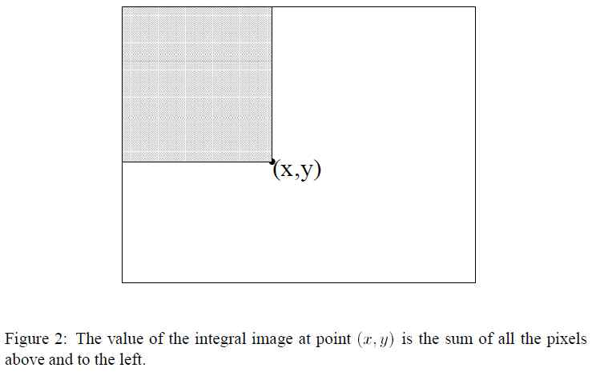
The Integral Image
What is the Integral Image? Figure is from Viola Jones paper

Slide 40
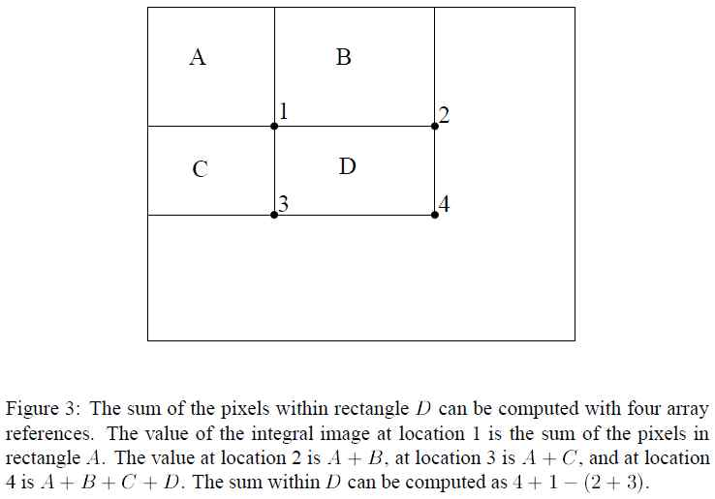
How does Integral Image help to compute the Rectangular Area’s sum?
Figure is from Viola Jones paper

Slide 41
How does Integral Image help to compute the Rectangular Area’s sum?
The previous slide shows the following: Suppose we are asked to compute the sum of pixels (in the picture) for a rectangular area, call the area D. Call the four corners of the rectangle, as 1, 2, 3 and 4.
Then, this sum of pixels in the rectangle D is given by:
Integral Image value at location 1
+ Integral Image value at location 4
- Integral Image value at location 2
- Integral Image value at location 3
Just 4 look-ups in the Integral Image array!!

Slide 42
This is how Final Big Speed-up occurs
So, any convolution with an expert pattern of the family shown in the example (remember there are four families), needs 8 lookups in the Integral Image (four lookups for each of two rectangles).
This constant computation time for the convolution is completely independent of how large or small the rectangle is.
The other three families need 8, 12 & 16 lookups, respectively.
The only additional expense is in computing the original Integral Image, but this is computed once (and is good for all experts). And this “once” is for the very large input image (of which small 50x50 windows will be cut and sent for testing.) Also, Integral Image can be computed in a manner that uses prior computed values.

Slide 43
This is how Final Big Speed-up occurs
So, any convolution with an expert pattern of the family shown in the example (remember there are four families), needs 8 lookups in the Integral Image (four lookups for each of two rectangles).
This constant computation time for the convolution is completely independent of how large or small the rectangle is.
The other three families need 8, 12 & 16 lookups, respectively.
The only additional expense is in computing the original Integral Image, but this is computed once (and is good for all experts). And this “once” is for the very large input image (of which small 50x50 windows will be cut and sent for testing.) Also, Integral Image can be computed in a manner that uses prior computed values.

Slide 44
One last comment on Integral Image
You probably have been wondering about how this system handles faces of different sizes; for example, how would a face that either appears in the picture as say 30x30, or appears as 80x80, how would it be detected? Obviously, there are two simple ways to proceed: One: the system needs to either scale (re-size) the candidate 80x80 or 30x30 window (or any other hypothesized size for that matter) to be 50x50 and then run everything as before. Two: would be to simply scale up (re-size) the expert patterns to the range of sizes needed, and then run everything as before, but with these new sizes. Both approaches work, but both require a lot of re-sizing (which is expensive).
The Integral Image makes it easy to adapt approach Two, by this: (see next slide)

Slide 45
One last comment on Integral Image
The Integral Image makes it easy to adapt approach Two, by this:
The expert patterns need to be scaled (up and down) to a range of scales (like, say, 30x30, and say, 80x80, as well as others). But, now, instead of actually scaling the expert pattern (and then doing the convolution), one simply has to re-compute the positions of the four corners of a rectangular area, then these new corner positions are used to lookup the Integral Image (which was already sitting there, pre-computed), and so, handling ranges of sizes, only needs to re-compute the positions of the four corners, nothing else!!
Thus the Integral Image has contributed to speeding up the basic convolution, and has simultaneously removed re-scaling problems.

Slide 46
Today
Administration
The Viola-Jones Face Detection: Big Picture
AdaBoost: Review
AdaBoost in Viola-Jones’ Context: Review
Integral Image: Final Big Speed-up

